Slide 1
天國服事的價值觀
True Value of the Servanthood in the Kingdom of God
路加 Luke 22:24-34

Slide 2
# 10 神僕當頌主 Ye Servants of God
1
屬主眾僕人，主恩當訴說，處處要宣揚，救主奇妙名。救主國度榮耀，祂統治萬民。耶穌得勝聖名，配受人頌稱。
2
神高天統治，大能施拯救，又處在人間，活在信徒中。會眾同聲歡唱，慶賀主得勝。稱頌君王耶穌，救贖大功成。

Slide 3
3
救贖的宏恩，歸於至高神，讓我眾人聲，榮耀聖子名。讚美救主耶穌，天使歌不停。羔羊面前俯伏，叩拜至虔誠。
4
我們當敬拜，主配受尊榮，智慧與權柄，皆歸主聖名。與眾天使讚美，主的大權能。感謝無窮大愛，歌聲永不停。

Slide 4
²⁴ 门徒起了争论：他们中间哪一个可算为大。
²⁵ 耶稣说：外邦人有君王为主治理他们，那掌权管他们的称为恩主。 ²⁶ 但你们不可这样，你们里头为大的，倒要像年幼的；为首领的，倒要像服侍人的。 ²⁷ 是谁为大？是坐席的呢，是服侍人的呢？不是坐席的大吗？
²⁴ A dispute also arose among them as to which of them was considered to be greatest. ²⁵ Jesus said to them, “The kings of the Gentiles lord it over them; and those who exercise authority over them call themselves Benefactors. ²⁶ But you are not to be like that. Instead, the greatest among you should be like the youngest, and the one who rules like the one who serves. ²⁷ For who is greater, the one who is at the table or the one who serves?

Slide 5
然而，我在你们中间如同服侍人的。 ²⁸ 我在磨炼之中，常和我同在的就是你们。 ²⁹ 我将国赐给你们，正如我父赐给我一样， ³⁰ 叫你们在我国里坐在我的席上吃喝，并且坐在宝座上审判以色列十二个支派。 ³¹ 主又说：西门，西门，撒旦想要得着你们，
Is it not the one who is at the table? But I am among you as one who serves. ²⁸ You are those who have stood by me in my trials. ²⁹ And I confer on you a kingdom, just as my Father conferred one on me, ³⁰ so that you may eat and drink at my table in my kingdom and sit on thrones, judging the twelve tribes of Israel. ³¹ “Simon, Simon, Satan has asked to sift all of you as wheat.

Slide 6
好筛你们像筛麦子一样。 ³² 但我已经为你祈求，叫你不至于失了信心。你回头以后，要坚固你的弟兄。 ³³ 彼得说：主啊，我就是同你下监，同你受死，也是甘心！ ³⁴ 耶稣说：彼得，我告诉你：今日鸡还没有叫，你要三次说不认得我。
³² But I have prayed for you, Simon, that your faith may not fail. And when you have turned back, strengthen your brothers.” ³³ But he replied, “Lord, I am ready to go with you to prison and to death.” ³⁴ Jesus answered, “I tell you, Peter, before the rooster crows today, you will deny three times that you know me.”

Slide 7
6月 28日 主日信息大綱
經文：路加福音 Luke 22:24-34 主題：天國服事的價值觀 Sermon Title: Evaluate the Servanthood in the Kingdom of God
教會中的張力：相愛又相爭 (v.24)
人間的領導觀 (作大的)：管治與福利 (v.25)
天國的領導觀：與人間價值對立的價值觀 (vs.26-27)
天國服事的榜樣：主耶穌自己 (vs.27-28)
天國服事的價值：天國的滿足與福分 (vs.28-29)
謹防破壞我們服事的仇敵：儆醒靠主得勝 (vs.31-34)

Slide 8
1
Tension among the church: To love each other or to dispute each other?
教會中的張力
相愛
相爭
vs
新人與舊人的相爭 (羅馬 7)
聖靈與情慾的相爭 (加拉太 5:17)
屬靈的與屬血氣的相爭 (加 4:29)
聖徒與屬靈氣的爭戰 (弗 6:12)
门徒起了争论：他们中间哪一个可算为大。
A dispute also arose among them as to which of them was considered to be greatest.
(1) New inner man vs Old sinful nature (Rom. 7) (2) The Holy Spirit vs sinful nature (Gal. 5:17) (3) The Holy Spirit vs Flesh (Gal 4:29) (4) Saints vs spiritual being living in the darkness (Eph. 6:12)
爭論：love of strife or strife itself.

Slide 9
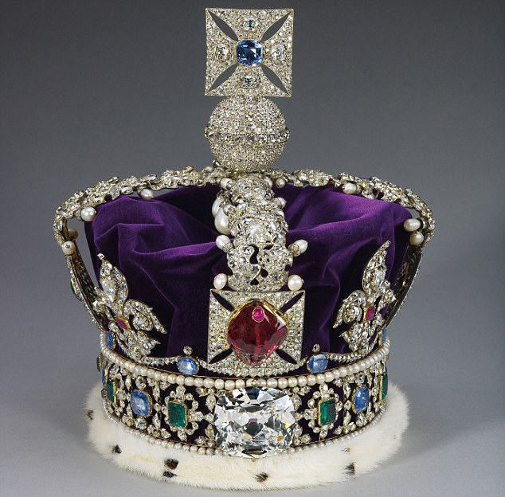
2
領袖觀的對立
Worldly values contradicts Spiritual values.
耶稣说：外邦人有君王为主治理他们，那掌权管他们的称为恩主。
屬地的領導人
Jesus said to them, “The kings of the Gentiles lord it over them; and those who exercise authority over them call themselves Benefactors.
以主人的心態治理人民
恩主：給人民好處的主人
(神的警告：申 17:14-20; 撒上 8:7-9, 22:7)
領導者有權力及武力、統治力
他們自稱為恩主
Call themselves benefactors
(1) Lord it over them. The forceful attitude of unchristian rulers. (2) The master of giving good to his people. (God’s warning; Deut. 17:14-20; 1 Sam. 8:7-9; 22:7). (3) Having the right, authority, to exercise power upon people.

Slide 10
對立的領袖觀
The attitudes of a spiritual leader
²⁶ 但你们不可这样，你们里头为大的，倒要像年幼的；为首领的，倒要像服侍人的。 ²⁷ 是谁为大？是坐席的呢，是服侍人的呢？不是坐席的大吗？然而，我在你们中间如同服侍人的。
屬靈領導人的服侍心態
甘心的服侍 (is willing service)
愛的服侍 (a loving service)
捨己的服侍 (self-denying service)
辛勤的服侍 (unwearied service)
不求回報的服侍 (is free service)
²⁶ But you are not to be like that. Instead, the greatest among you should be like the young-est, and the one who rules like the one who serves. ²⁷ For who is greater, the one who is at the table or the one who serves? Is it not the one who is at the table? But I am among you as one who serves.
效法基督道成肉身的服事 Jesus’ Incarnation Servanthood
服侍: Deacon, Compassion service
腓立比 Philp. 2:3-7

Slide 11
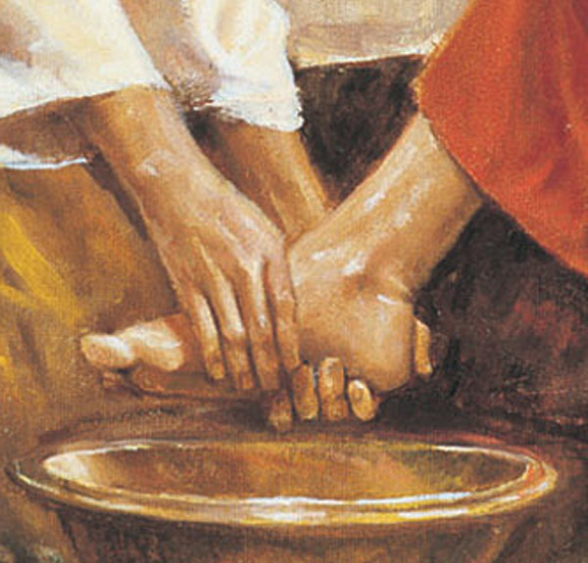
以救贖為中心的服侍
How a spiritual leader to serve others?
屬靈領導人如何服侍？
²⁸ 我在磨炼之中，常和我同在的就是你们。 ³¹ 主又说：西门，西门，撒旦想要得着你们，好筛你们像筛麦子一样。 ³² 但我已经为你祈求，叫你不至于失了信心。你回头以后，要坚固你的弟兄。
耶穌來是拯救罪人，恢復人被造的目的與尊榮
拯救世上罪人脫離魔鬼及罪的權勢，使之與神、自己及他人和好。經由聖潔、公義、饒恕、愛與被愛，醫治人身心靈的創傷，更新及復興他們。給人屬靈指引為神而活。幫助及安慰受壓迫、貧窮、苦難中的人，使他們得著真正的盼望，並見證主耶穌永遠的救恩。
²⁸ You are those who have stood by me in my trials. ³¹ “Simon, Simon, Satan has asked to sift all of you as wheat. But I have prayed for you, Simon, that your faith may not fail. And when you have turned back, strengthen your brothers.”
It is to sinners that Jesus’ service is rendered; We need forgiveness, cleansing, healing, strength, wisdom, faith, protection. In every scene and place and duty and struggle and trial He will be at our side, as the servant, to minister to us in everything, so that in nothing we may be found lacking.
This Photo by Unknown Author is licensed under CC BY-NC-ND

Slide 12
3
主耶穌服事的榜樣
Serve Like Jesus
“Lead Like Jesus” by Ken Blanchard & Phil Hodges, 2005, W Publishing Group
主耶穌的心
以基督的心為心
主耶穌的手
幫助門徒生命成長
單單高舉神──謙卑、信心，神是我們侍奉的唯一裁判者。
幫助跟隨者屬靈成長──門徒訓練、新手、熟手、大師
服侍是基督生命的彰顯
主耶穌的習慣
服事得能力的秘訣
主耶穌的頭
更新門徒的宇宙觀
與神獨處、愛神愛人──使用神的話、順從神旨意、活出活潑有信心的生命
激發神國願景──以愛、犧牲朝向目標
(1) Jesus’ heart: honoring God alone, humble & faithfulness. (2) Jesus’ head: giving people glorious vison of kingdom of God, leads them approach the goal with love & sacrifices. (3) Jesus’ hands: to lead His followers grow through discipleship. (4) Jesus’ habits: abides in God and prays to God constantly, loves God & people, to demonstrate living hope & faith to God by obeying God’s will.

Slide 13
4
衡量天國服事的價值
Evaluation of spiritual service
服侍主中勝過試驗 (v.28)
忠於主的付託 (v.29)
作得勝者 (v.30a, Rev. 3:21)
以生命來審判人 (v.30b)
²⁸ 我在磨炼之中，常和我同在的就是你们。²⁹ 我将国赐给你们，正如我父赐给我一样， ³⁰ 叫你们在我国里坐在我的席上吃喝，并且坐在宝座上审判以色列十二个支派。
Overcomes the trails during serving (v.28)
Faithful to the appointed ministries (v.29)
Be a victor (v.30b; cf. Rev. 3:21)
Judge unbelievers with testimony of life (v.30b; cf. 1Pet. 2:12)
²⁸ You are those who have stood by me in my trials. ²⁹ And I confer on you a kingdom, just as my Father conferred one on me, ³⁰ so that you may eat and drink at my table in my kingdom and sit on thrones, judging the twelve tribes of Israel.
以此四點來衡量信徒的服事是否有價值？Using 4 points to evaluate our service

Slide 14
5
天國服事的滿足與福分
The satisfaction & blessings of spiritual service
有意義重於成功
有永恆的果效重於短暫的存在
基督耶穌是我生活的力量、是我臨終的盼望、是我復活的凱歌、是我永世裡永恆的榮耀。
因此，服事主是我人生最大的滿足與祝福。
²⁸ 我在磨炼之中，常和我同在的就是你们。²⁹ 我将国赐给你们，正如我父赐给我一样， ³⁰ 叫你们在我国里坐在我的席上吃喝，并且坐在宝座上审判以色列十二个支派。
²⁸ You are those who have stood by me in my trials. ²⁹ And I confer on you a kingdom, just as my Father conferred one on me, ³⁰ so that you may eat and drink at my table in my kingdom and sit on thrones, judging the twelve tribes of Israel.
(1) Significant vs. Successful. (2) Eternal matter vs. temporary matter. (3) The Christ is my living strength, my dying hope, my raising song and eternal glory. (4) Therefore, to serve the LORD is my eternal satisfaction & blessings.

Slide 15
6
謹守仇敵的破壞
Be aware of devil’s attacking
³¹主又说：西门，西门，撒旦想要得着你们，好筛你们像筛麦子一样。
³² 但我已经为你祈求，叫你不至于失了信心。你回头以后，要坚固你的弟兄。 ³⁴ 耶稣说：彼得，我告诉你：今日鸡还没有叫，你要三次说不认得我。
看哪：耶穌看見，門徒卻未見
撒旦要筛你们：要求再擄掠回來
像筛麦子：旋轉、暈眩、全身破口
失去信心：懷疑主的可靠、旨意、能力
主事先為門徒禱告：主的預知及施恩
回頭之後：回轉回來信靠主
堅固你的弟兄：是命令，也是責任
³¹ “Simon, Simon, Satan has asked to sift all of you as wheat. ³² But I have prayed for you, Simon, that your faith may not fail. And when you have turned back, strengthen your brothers.” ³⁴ Jesus answered, “I tell you, Peter, before the rooster crows today, you will deny three times that you know me.”
(1) Behold, Jesus sees it first. (2) Satan asked permission from God to do something. (3) To shit someone is to confuse and discourage him. (4) Lost faith is to doubt the faithfulness, power and good will of the LORD. (5) Jesus foresees everything & to pray for disciples before their failures. (6) By Jesus’ grace and help, disciples able to return to Him after their failures. (7) Jesus commands Peter to take responsibility to sustain weaker brothers.

Slide 16
結論
經文：路加福音 Luke 22:24-34
主題：天國服事的價值觀
Sermon Title: Evaluate the Servanthood in the Kingdom of God
教會中的張力：相愛又相爭 (v.24)
人間的領導觀 (作大的)：管治與福利 (v.25)
天國的領導觀：與人間價值對立的價值觀 (vs.26-27)
天國服事的榜樣：主耶穌自己 (vs.27-28)
天國服事的價值：天國的滿足與福分 (vs.28-29)
謹防破壞我們服事的仇敵：儆醒靠主得勝 (vs.31-34)

